Slide 1


Group 1
B Daves, Grant Cheney, David Fried
Javane Jones, Chioma Maduko, Oleg Ryzhkov
July 28, 2020
Chicago Crime & Well-Being Project
Notes:
1:30 intro of names, project name,

Slide 2






Crime Investigators
CHICAGO CRIME & WELL-BEING TRENDS
Chioma Maduko
Project Admin/Moderator
Oleg Ryzhkov
State Analysis
Grant Cheney
Neighborhood Analysis
Javane Jones
Neighborhood Analysis
David Fried
Neighborhood Analysis
B Daves
City Level Analysis
- Data sources
- Data finding
- Data exploration
- Data analysis
- Data exploration
- Data analysis
- State and City crime mapping and visualization
- GitHub Moderator
- Data analysis
- Neighborhood crime mapping and visualization
- Data import, cleaning, and merging
- Crime type analysis and visualization
-Data exploration
- Correlation and Regression
- 3d regression visualization
- Data exploration
- Data analysis

Slide 3
EXECUTIVE SUMMARY
Socioeconomic influences on crime
Research Objective:
Crime and death patterns between states and neighborhoods, including different types of crime.
The influence of Health, birth, and economic factors on crime rates:
Between U.S. states
Between Chicago neighborhoods
Hypothesis:
U.S. states and Chicago neighborhoods that have populations with poorer health, more teen pregnancies, and higher unemployment experience greater crime.
Results:
States with more poverty and unemployment had greater property crime and violence. Chicago neighborhoods with poorer health conditions (e.g., more individuals with cancer and stroke), more teen pregnancies, and higher unemployment rates had greater neighborhood homicide rates.
Notes:
Discuss health/social and economic factors at state level, such as …. Cancer, birth rates
Discuss health/social and economic factors at neighborhood level, such as …per capita member

Slide 4






Data CleanUp and Import: Summary
CHICAGO CRIME & WELL-BEING TRENDS
DataSet Description
79 US big cities with murder statistics
788 US major cities over 50k population
Economic indicators across US States
US States Crime Statistics (Violence and Property Crime)
Leading Deaths Causes across US States
Reported crime (over 7 million cases) and Chicago neighborhood health, birth, and economic factors (77 cases)

Slide 5
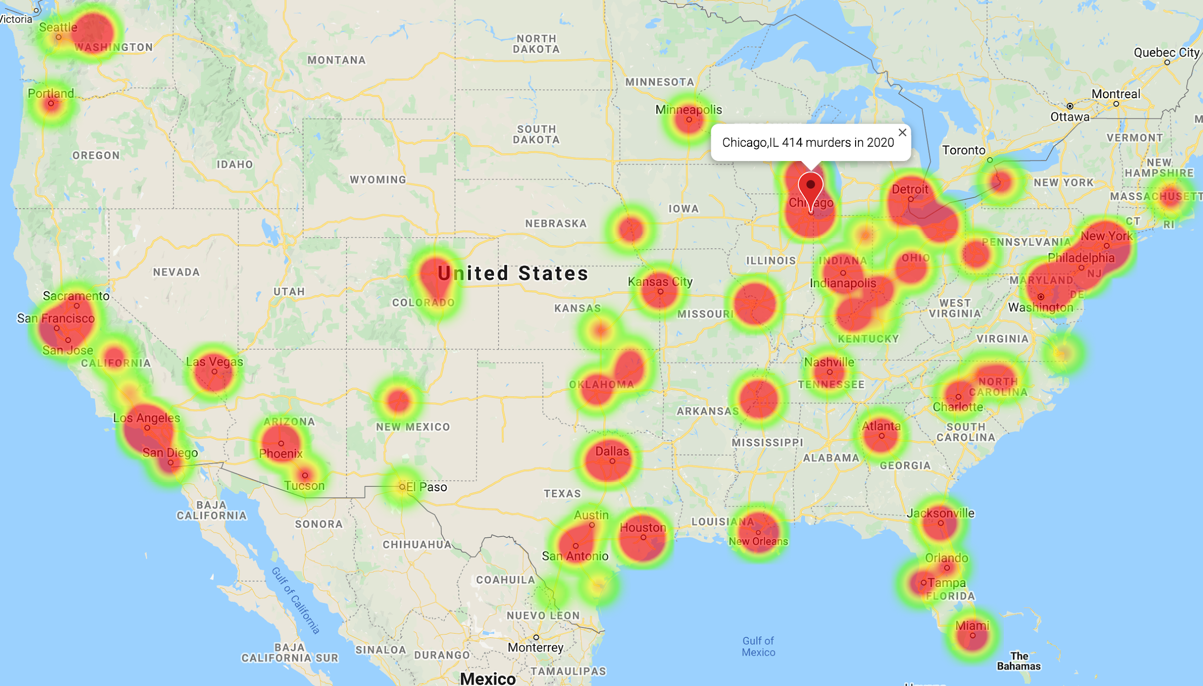
Myth or Reality: Is Chicago the US Crime Capital?
CHICAGO CRIME & WELL-BEING TRENDS
Top Crime Cities by murders | 2014 | 2015
Chicago | 411 | 478
New York | 333 | 352
Baltimore | 211 | 344
Houston | 242 | 303
Detroit | 298 | 295
Los Angeles | 260 | 282
Philadelphia | 248 | 280

Slide 6
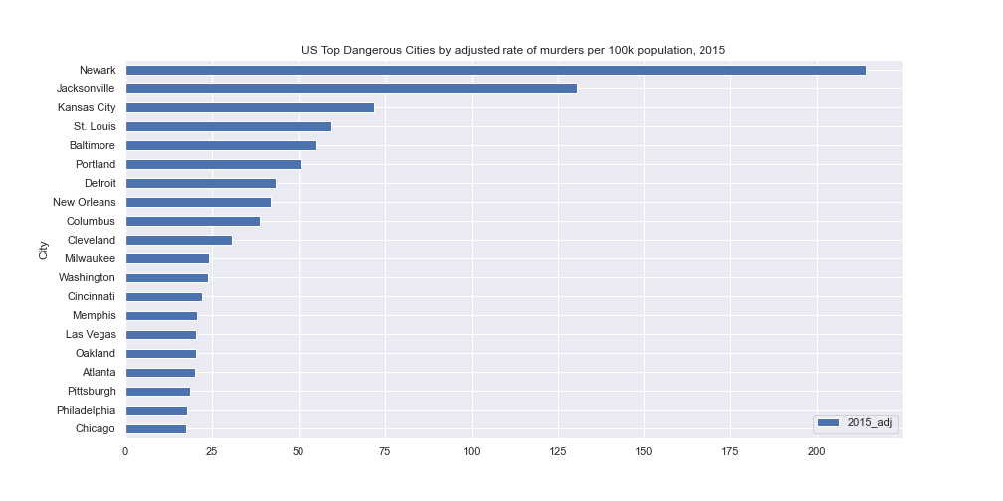
Data Exploration: Top US Dangerous Cities
CHICAGO CRIME & WELL-BEING TRENDS

Slide 7
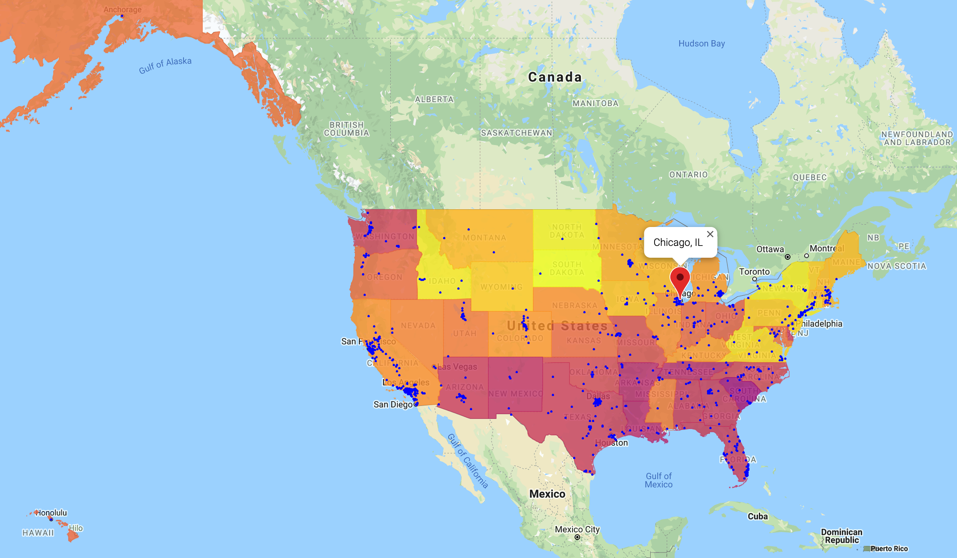
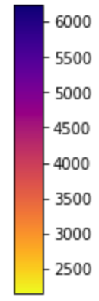
Data Visualization: Adjusted Crime Rate at State Level (per 100k)
CHICAGO CRIME & WELL-BEING TRENDS
Adjusted Crime Rate by Types, USA | 2011
All Types | 3,346
Property Crime | 2,953
Burglary | 713
Larceny | 2,006
Motor | 234
Violence Crime | 393
Assault | 245
Murder | 5
Rape | 27
Robbery | 116

Slide 8
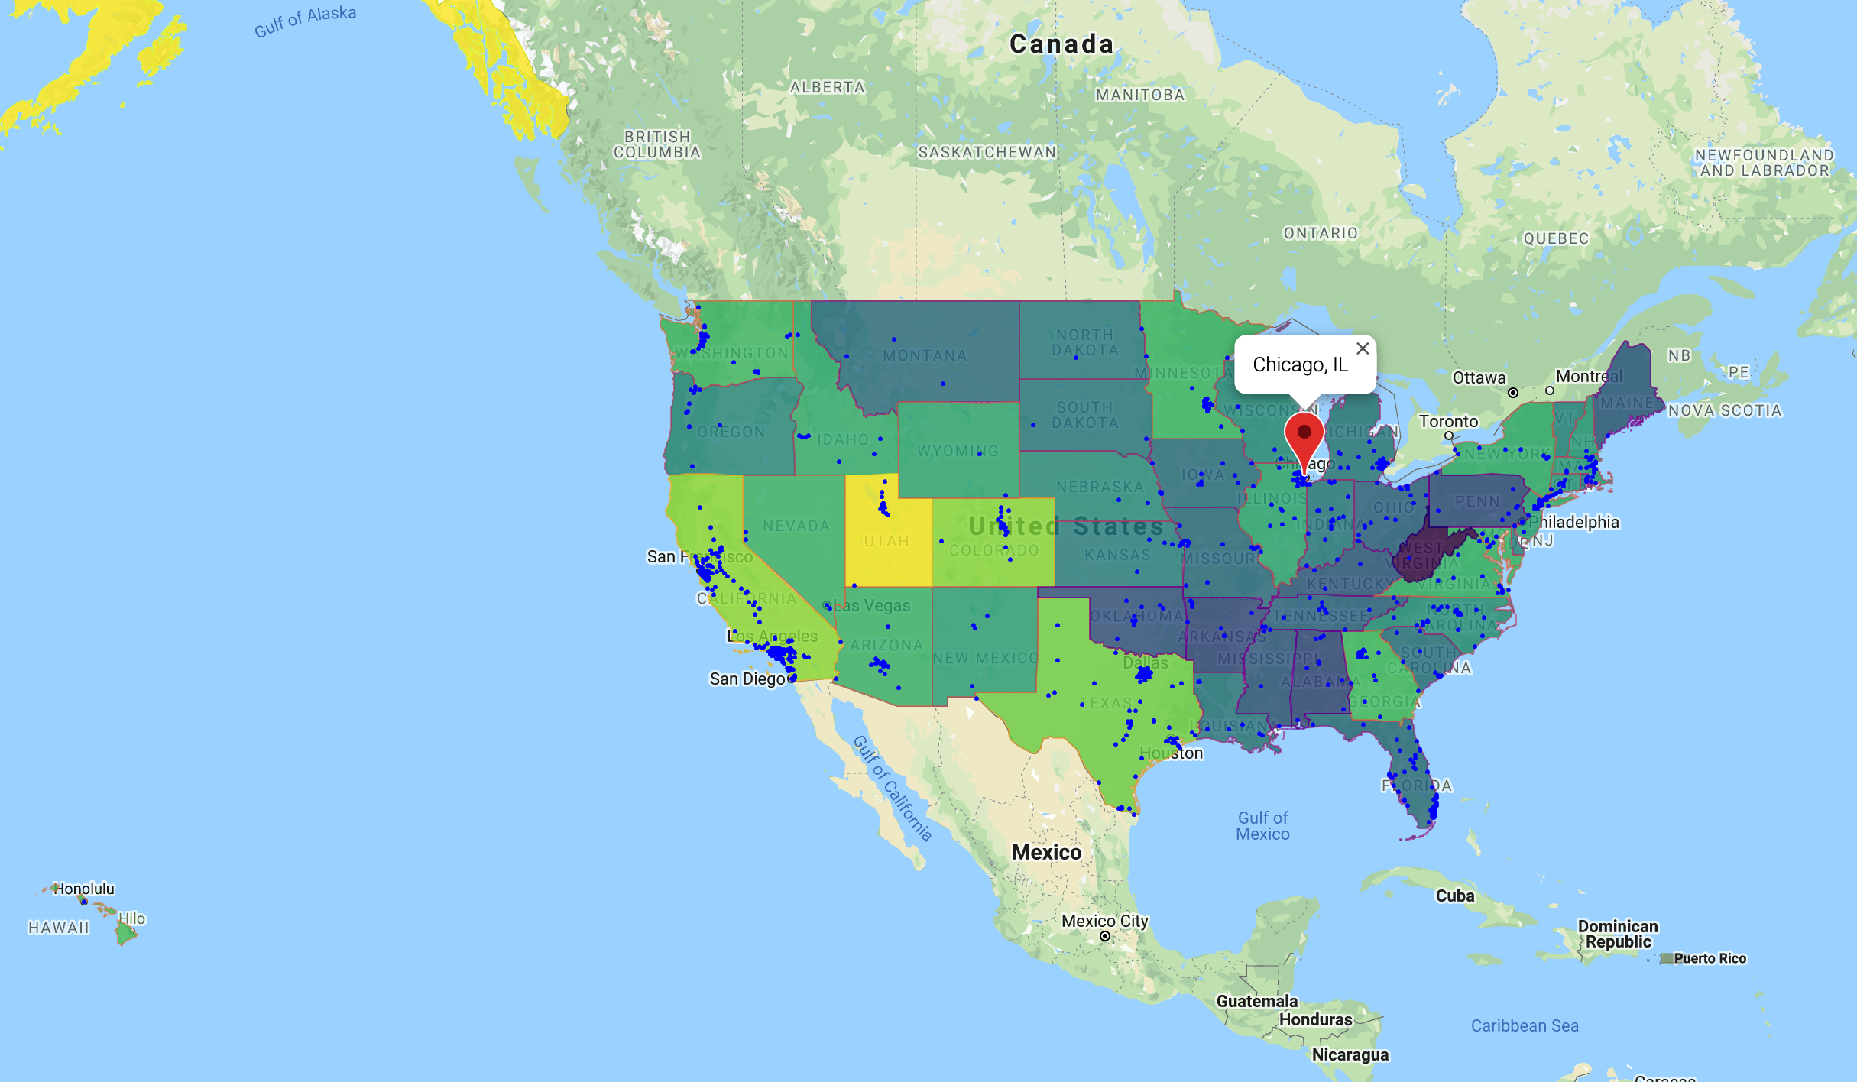
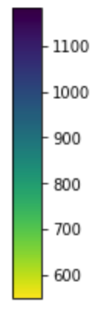
Data Visualization: Adjusted Death Rate at State Level (per 100k)
CHICAGO CRIME & WELL-BEING TRENDS
Adj Death Rate by Leading Causes, USA | 2011
All Causes | 820
Heart Disease | 195
Cancer | 188
CLRD | 46
Stroke | 42
Unintentional injuries | 41
Alzheimer | 27
Diabet | 24
Influenza and Pneumonia | 18
Suicide | 13

Slide 9
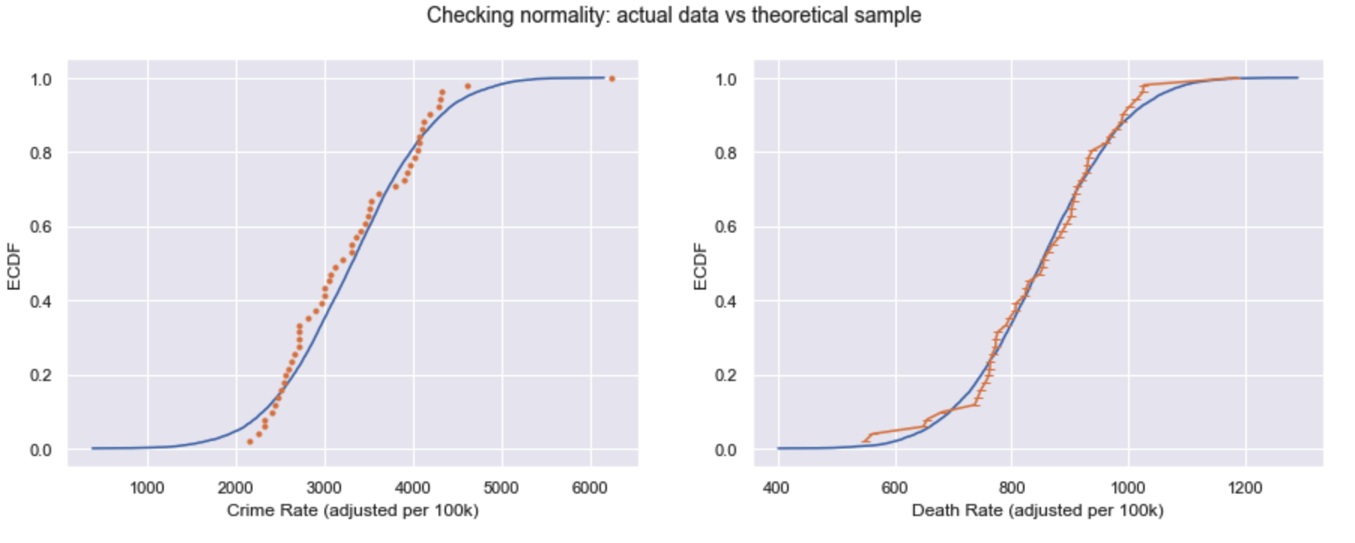
Data Exploration: State Level
CHICAGO CRIME & WELL-BEING TRENDS

Slide 10
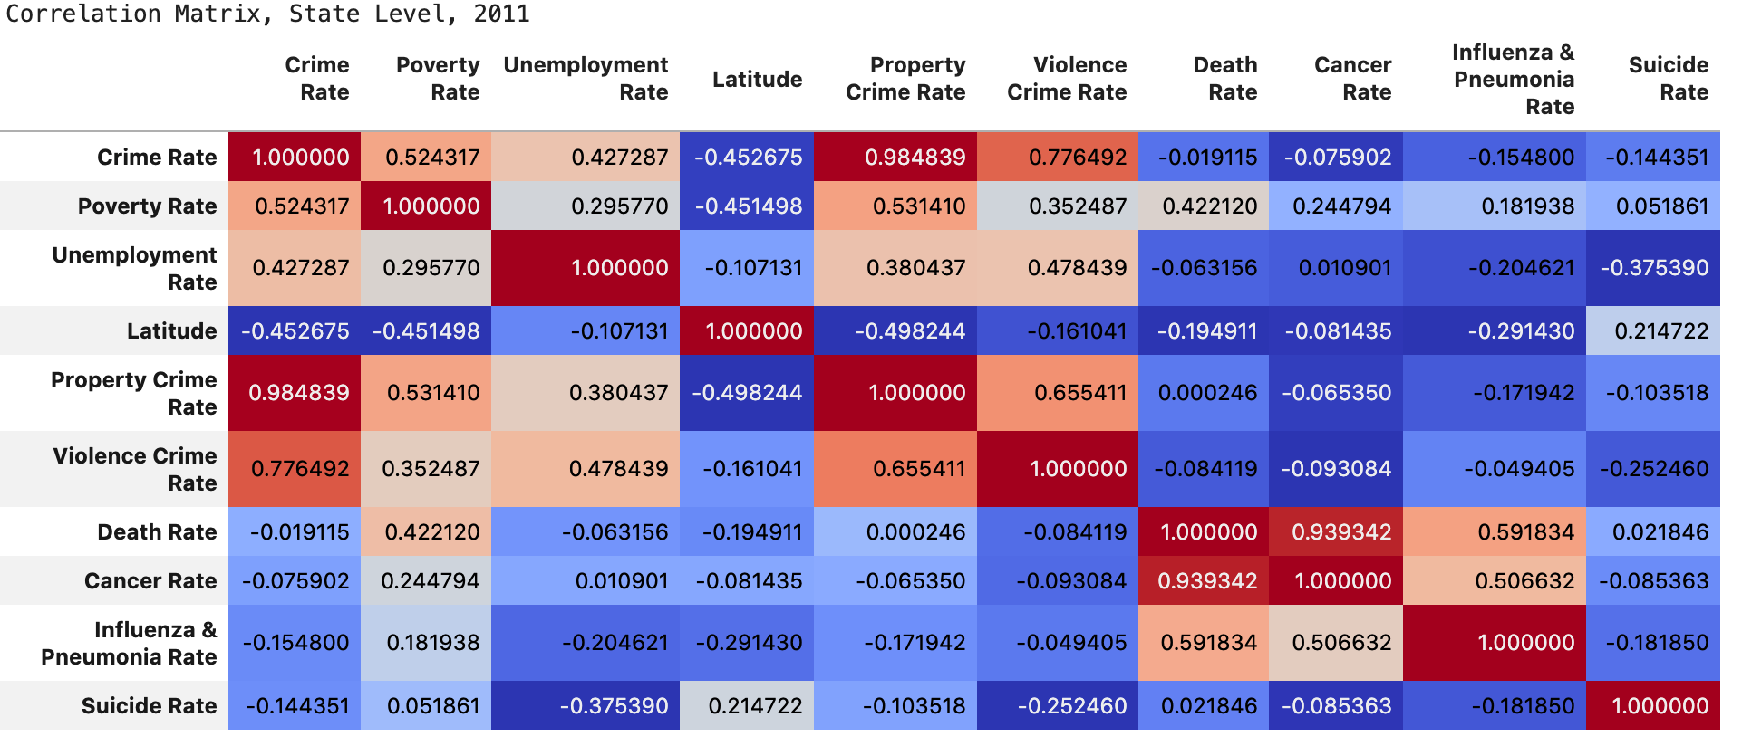
Data Analysis: State Level
CHICAGO CRIME & WELL-BEING TRENDS

Slide 11
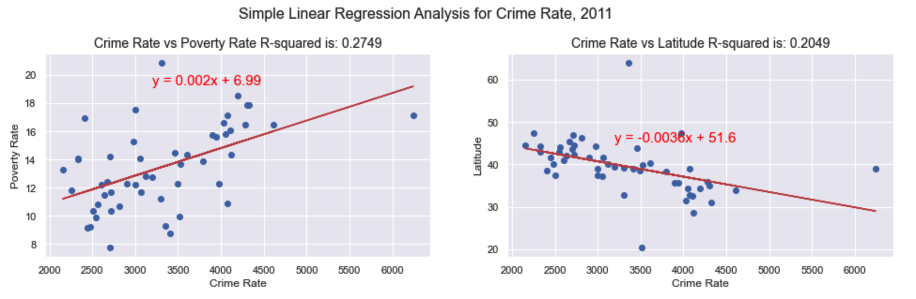
Statistical Analysis: State Level
CHICAGO CRIME & WELL-BEING TRENDS
Anova Test for the Adjusted Crime Rate
Null Hypothesis: no difference between southern and northern states -Rejected

Slide 12

Data Visualization: Chicago Neighborhood Homicide Rate (per 100k)

Slide 13

Data Visualization: Chicago Neighborhood Homicide Rate (per 100k)

Slide 14

Data Visualization: Chicago Neighborhood Homicide Rate (per 100k)

Slide 15
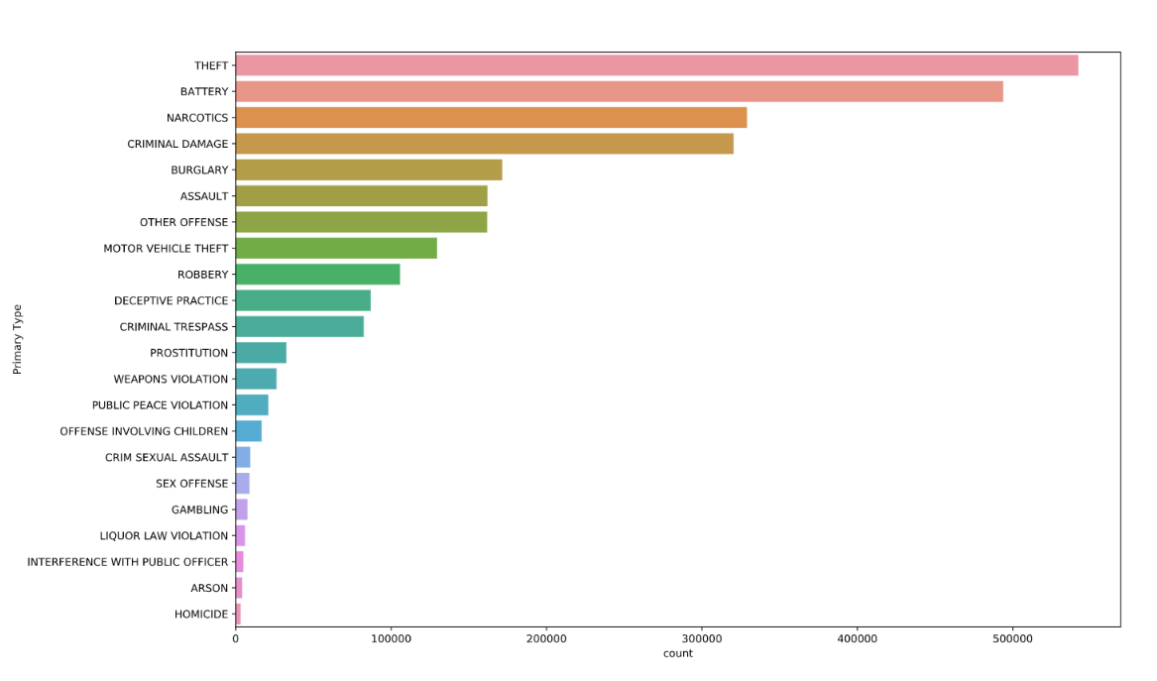
Data Exploration: Crime Type
CHICAGO CRIME & WELL-BEING TRENDS

Slide 16
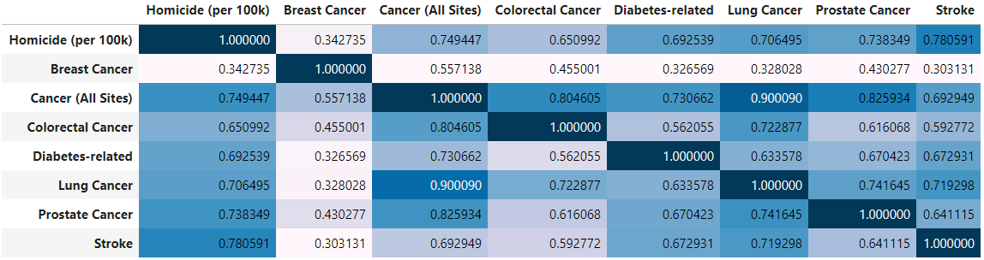
Data Exploration: Health Factors
The relationship of health factors with Homicide Rate (per 100k)
Nn = 77 (neighborhoods)
Notes:
Stroke has the highest correlation.

Slide 17
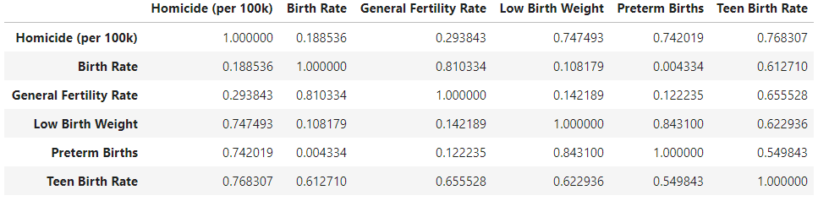
Data Exploration: Birth Factors
CHICAGO CRIME & WELL-BEING TRENDS
Nn = 77 (neighborhoods)
Notes:
Teen birth rate has the highest correlation.

Slide 18
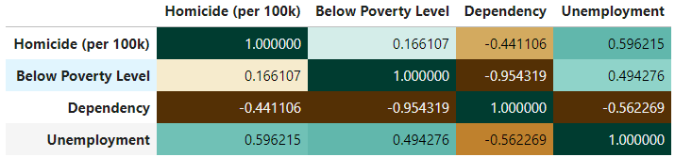
Data Exploration: Economic Factors
CHICAGO CRIME & WELL-BEING TRENDS
Nn = 77 (neighborhoods)
Notes:
Unemployment had the strongest correlation.
Performed a series of multiple regression analysis to determine which variables explained the most variation in homicide rate.
The teen birth rate and unemployment survived.
Higher teen birth rate and more unemployment was associated with more murder.

Slide 19
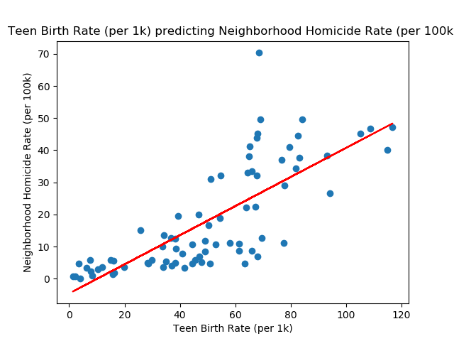
Statistical Analysis: Summary
CHICAGO CRIME & WELL-BEING TRENDS
Regressing neighborhood homicide rate (per 100k) on the teen birth rate (per 1k).
X = Teen Birth Rate Homicide_Rate = 0.45(X) - 4.6
r = 0.77 p < .001 R_squared = 0.59
Interpretation: An increase in teen birth rate is associated with an increase in the neighborhood homicide rate, p < .05.
*Using a log transformation to normalize homicide rate improved the r_squared to 0.68 (see Appendix).
Notes:
Explained 59% of the variation in homicide rate.

Slide 20
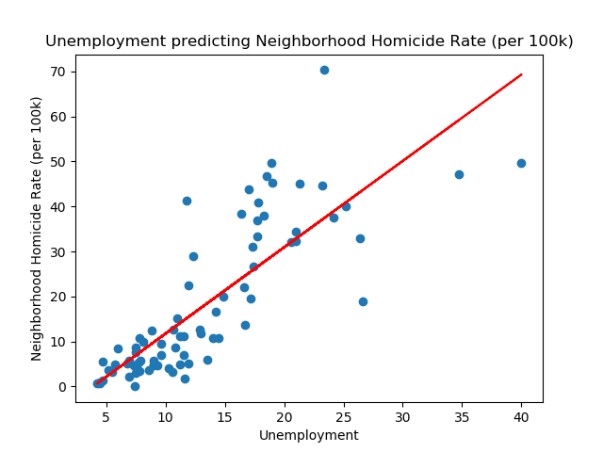
Regressing neighborhood homicide rate (per 100k) on unemployment (%)..
X = Unemployment Homicide_Rate = 1.92(X) - 7.46
r = 0.81 p < .001 R_squared = 0.66
Interpretation: An increase in unemployment is associated with an increase in the neighborhood homicide rate, p < .05.
*Using a log transformation to normalize homicide rate decreased r_squared (very slightly) to 0.63 (see Appendix).
Statistical Analysis: Summary
CHICAGO CRIME & WELL-BEING TRENDS
Notes:
Explained 66% of the variation in homicide rate.
Notice some heteroscedasticity of the distribution or errors around the regression line.
As unemployment increases the distribution of errors become much wider

Slide 21
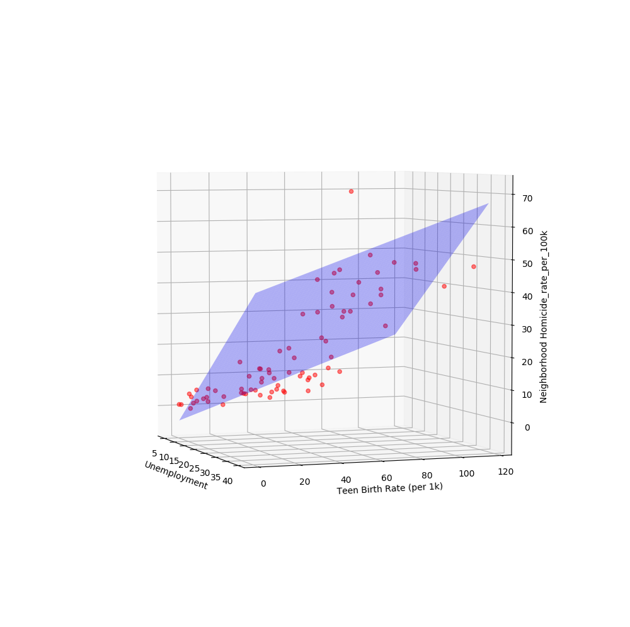
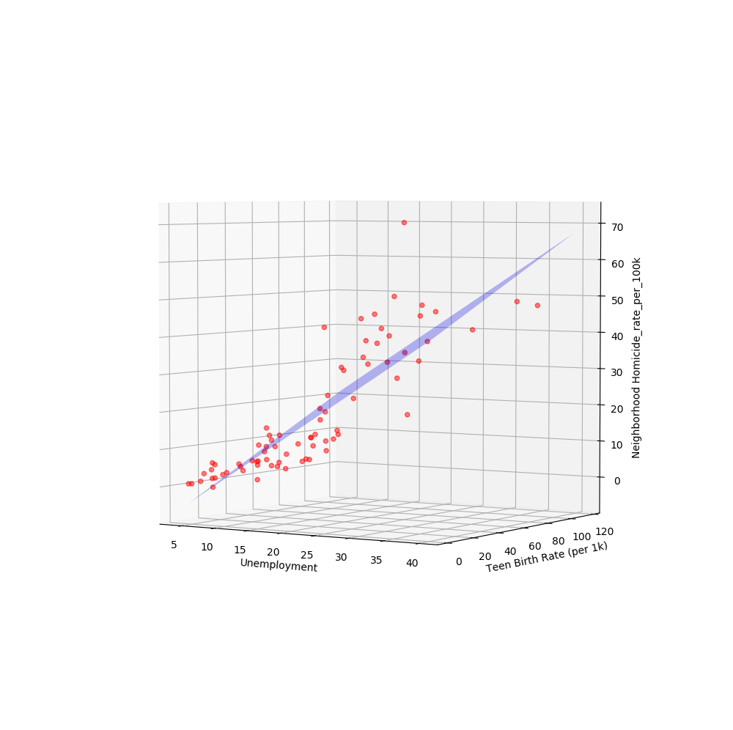
t = teen birth rate (per 1k)
u = unemployment (%)
*See appendix for results
Statistical Analysis: Summary
CHICAGO CRIME & WELL-BEING TRENDS
Regressing Neighborhood Crime Rate on Teen Birth Rate and Unemployment
Predicted_homicide_rate = -10.1931 + 0.2246(t) + 1.2792(u)
F = 102.80, p < .001, R_squared = 0.74
Notes:
Here is a visualization of a multiple regression. Results are in appendix.

Slide 22
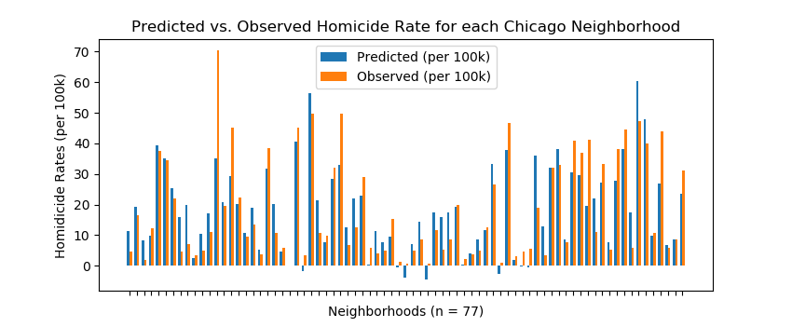
Statistical Analysis: Summary
CHICAGO CRIME & WELL-BEING TRENDS
Notes:
Predicted from teen pregnancy and unemployment.
Notice some predicted values were negative. This was because the predicted values are theoretical and many actual values were near zero.

Slide 23
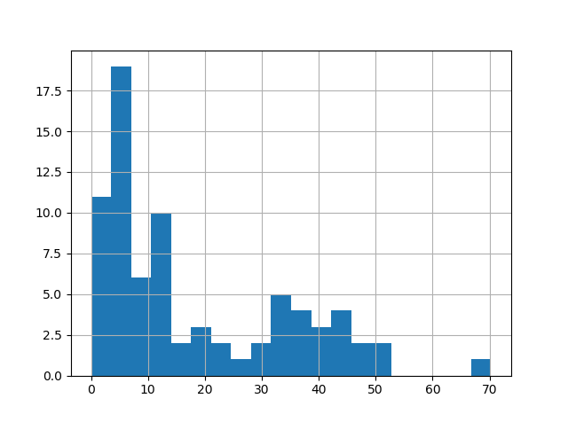
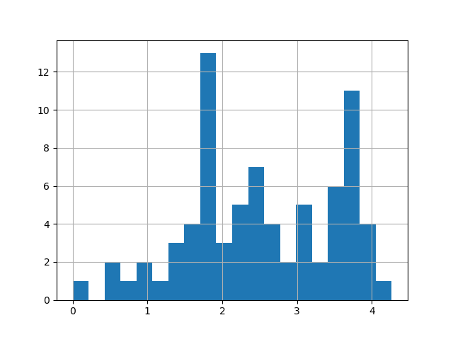
Data Exploration:
Normality of Neighborhood Homicide Rate
Histogram of Homicide Rate (per 100k)
Log Transformation: Histogram of Homicide Rate (per 100k)
Notes:
One thing I didn’t mention was that homicide rate was not normally distributed, which violates one of the assumptions of regression analysis. The homicide rate was very positively skewed because there were many neighborhoods with zero or near-zero homicide rates. (This typically increases the chance of making a Type II error, which is the probability of claiming there are no statistically significant differences when in fact there are.)
I performed a log transformation on the homicide rate. As you can see, it is now more normally distributed.
I then re-ran the regression analyses.
Substantially improved the fit of the multiple regression model
Kurtosis statistic was no longer statistically significant
R square was nearly identical to the adjusted R square
Model explained additional 3% of the variation.
The distribution of errors around the regression line appear much more homogeneous.
These results can be found in the appendix of this presentation.

Slide 24
Conclusion: Key Findings
CHICAGO CRIME & WELL-BEING TRENDS
Research Objective
Crime and death patterns between states and neighborhoods, including different types of crime.
The influence of health, birth, and economic factors on crime rates:
Between U.S. states
Between Chicago neighborhoods
Results:
Chicago neighborhoods with unhealthier populations (e.g., higher cancer and stroke rates), more teen births, and higher unemployment rates had more murders.
States with higher poverty and unemployment experienced more violence and property crimes.
Other interesting findings:
Contrary to popular belief, the murder rate in Chicago is lower than many other major cities when the murder rate is adjusted for population size.
There were no correlations between health factors and crime rates when analyzing differences between states.

Slide 25
Discussion: Research Conclusions
CHICAGO CRIME & WELL-BEING TRENDS
Results generally support our hypotheses.
However, there was no relationship between health and crime between states.
based on aggregated data (e.g., aggregated at neighborhood and state level)
Well-being measure:
need more measures of health factors
need psychological measures
Need more measures economic measures
state level)
Well-being measure:
need more measures of health factors
need psychological measures
Need more measures economic measures
Notes:
Explain why we think there was no relationship between health and crime when analyzing between states.

Slide 26
Discussion: Practical Implications
CHICAGO CRIME & WELL-BEING TRENDS
More sex education
Raise the minimum wage
Increase welfare services
Improve healthcare
based on aggregated data (e.g., aggregated at neighborhood and state level)
Well-being measure:
need more measures of health factors
need psychological measures
Need more measures economic measures
state level)
Well-being measure:
need more measures of health factors
need psychological measures
Need more measures economic measures
Notes:
Sex education: Discouraging teens from becoming pregnant may decrease stress, which could reduce tendency toward violent crime. (increase sex education)
Raising the minimum wage and increasing welfare services: may reduce stress associated with low income which might decrease the tendency toward violent crime.
Improving healthcare

Slide 27
Discussion: Limitations
CHICAGO CRIME & WELL-BEING TRENDS
Research design (cross-sectional )
Levels of analysis
Measures
Lack of controls
Potential violation of assumptions for regression in neighborhood analysis
Non-normality of outcome variable (homicide rate)
Potential heteroscedasticity
based on aggregated data (e.g., aggregated at neighborhood and state level)
Notes:
Research design (cross-sectional ): Correlation does not prove causation. Cannot rule out confounds.
Levels of analysis: Factors that differ between neighborhoods and state influence the crime rate. Makes this difficult to draw conclusions about how these factors predict individual differences in the crime rate.
Measures: Didn’t include factors such as obesity and smoking. Limited measure of crime: Only measured murder, violent crime, and property crime.
Lack of controls: Didn’t control for factors such as age.
Non-normality: tried simple transformations like square, cube, and square root but did not work. Would try a Box-Cox power transformation.

Slide 28
Discussion: Future Research
CHICAGO CRIME & WELL-BEING TRENDS
Different measures of health and economic factors
Measures of psychological well-being (e.g., happiness and self esteem)
Different measures of crime (e.g., sexual crimes and different types of violent crimes)
Additional analyses (e.g., hierarchical regression analysis and exploratory factor analysis)
based on aggregated data (e.g., aggregated at neighborhood and state level)
Well-being measure:
need more measures of health factors
need psychological measures
Need more measures economic measures
state level)
Well-being measure:
need more measures of health factors
need psychological measures
Need more measures economic measures
Notes:
Additional analyses:
Hierarchical Regression Analysis (unique contribution of variance from economic versus health factors)
Exploratory Factor Analysis (empirically-driven approach to grouping health, birth, and economic variables into factors)

Slide 29
Appendix

Slide 30
Data CleanUp and Import: Summary
Program Code | Description | Data Period | Data Source | Data Type | Output
major_cities.ipynb | 79 US big cities with murder statistics | 2014, 2015, 2016(prel) | Data.org, GoogleMap | csv, api json | csv, png
 | 788 US major cities over 50k population | 2010-2019 (estimate) | Census.org, GoogleMap | xlsx, api json | csv, png
census_states.ipynb | Economic indicators across US States | 2010-2018 | Census.org, | csv, api json | csv, png
 | US States Crime Statistics (Violence and Prop Crime) | 1960-2012 | GitHub | csv | csv, png
cdc_states.ipynb | Leading Deaths Causes across US States | 1999-2017 | CDC (Centers for Disease Control and Prevention) | csv, api json | csv, png
nbhd_data_explorator1.ipynb | Cleaned, transformed, and merged data from crime reports from victims in Chicago with neighborhood health and economic information | 2005-2011 | Chicago Data Portal | csv | csv
Nbhd_data_explorator1.ipynb & nbhd_data_explorator2.ipynb | Performed correlational and regression analyses | 2005-2011 | Chicago Data Portal | csv | csv, png
nbhd_final_analysis.ipynb | Performed final analyses used in presentation | 2005-2011 | Chicago Data Portal | csv | csv, png
nbhd_final_analysis_with_log_transformation.ipynb | Performed log transformation on homicide rate and re-ran regression analysis | 2005-2011 | Chicago Data Portal | csv | csv, png

Slide 31
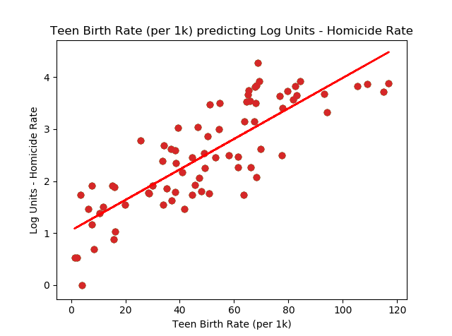
Statistical Analysis: Log Units
CHICAGO CRIME & WELL-BEING TRENDS
y = 0.03x + 1.05
r = 0.83, p = 0.0000, r_squared = 0.68

Slide 32
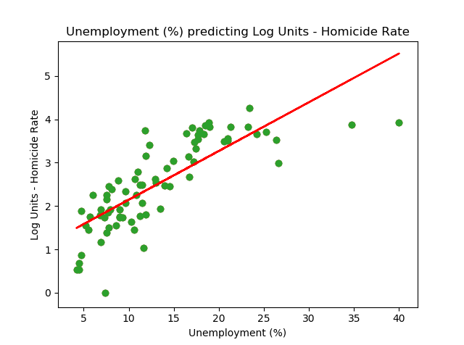
Statistical Analysis: Log Units
CHICAGO CRIME & WELL-BEING TRENDS
y = 0.11x + 1.02
r = 0.79, p = 0.0000, r_squared = 0.63

Slide 33
Multiple Regression Results: No Transformation
CHICAGO CRIME & WELL-BEING TRENDS
Regressing Neighborhood Homicide Rate on Teen Birth Rate and Unemployment
Model | OLS, Non-Robust |  | R-Square | 0.74
Obs | 77 |  | Adj R-Square | 0.73
Df residual | 74 |  | F | 102.80
Df model | 2 |  | p value | 0.000
Equation | Coefficient |  | Standard Error | T statistic | p value
Constant | -10.1931 |  | 2.203 | -4.63 | 0.000
Teen Birth Rate | 0.2246 |  | 0.050 | 4.47 | 0.000
Unemployment | 1.2792 |  | 0.201 | 6.37 | 0.000

Slide 34
Multiple Regression Results: Log Transformation
CHICAGO CRIME & WELL-BEING TRENDS
Regressing Neighborhood Homicide Rate on Teen Birth Rate and Unemployment
Model | OLS, Non-Robust |  | R-Square | 0.77
Obs | 77 |  | Adj R-Square | 0.76
Df residual | 74 |  | F | 122.70
Df model | 2 |  | p value | 0.000
Equation | Coefficient |  | Standard Error | T statistic | p value
Constant | 0.7939 |  | 0.124 | 6.41 | 0.000
Teen Birth Rate | 0.0189 |  | 0.003 | 6.67 | 0.000
Unemployment | 0.0587 |  | 0.011 | 5.19 | 0.000

Slide 35
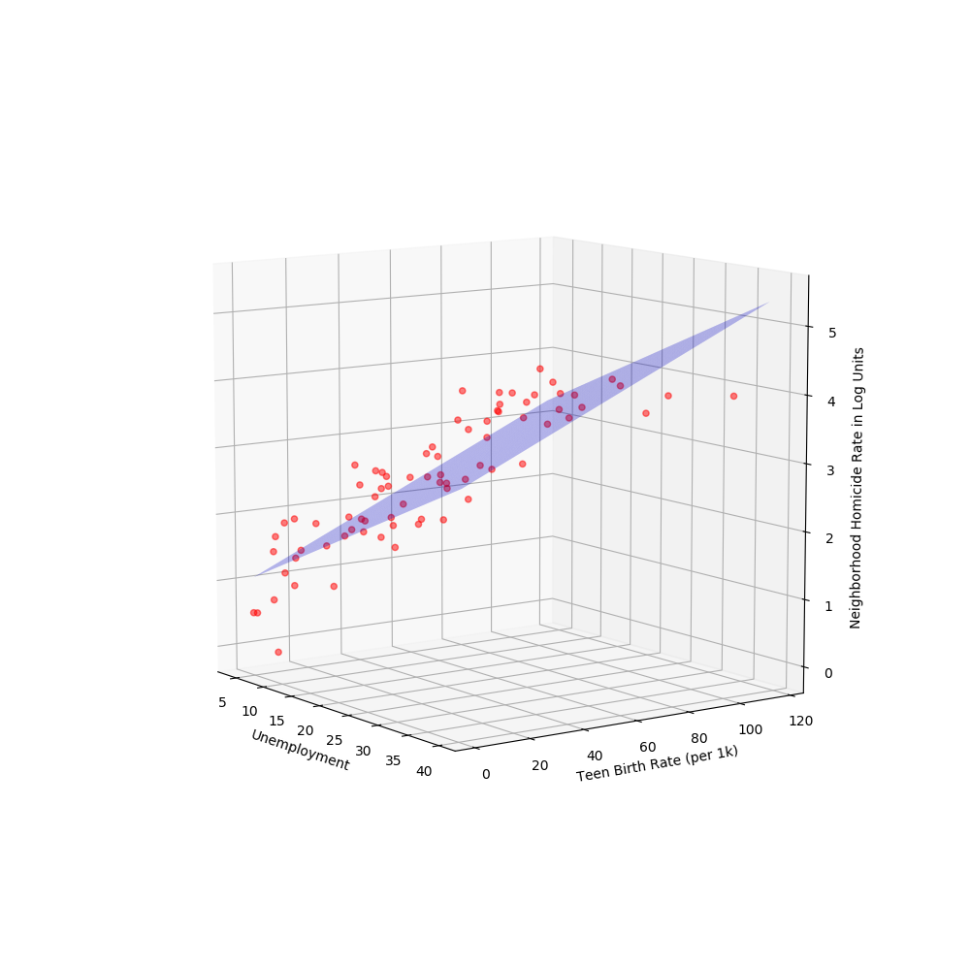
Multiple Regression Results:
Log Units
Predicted_homicide_rate = 0.7939 + 0.0189(t) + 0.0587(u)
F = 122.70, p < .001, R_squared = 0.77

Slide 36
Chicago Neighborhood Public Health Data
#Data collected by the Chicago Department of Public Health (CDPH) from 2005 to 2011 (“Neighborhood_Health.csv”)
77 cases (one for each neighborhood)
27 indicators of public health significance by Chicago community area
The indicators are rates, percents, or other measures related to natality, mortality, infectious disease, lead poisoning, and economic status.
Measures include teen birth rate , unemployment rate, and homicide rate

Slide 37
Chicago Neighborhood Public Health Data (Continued)
Homicide rate: The homicide rate is the age-adjusted rate per 100,000 people in a specific neighborhood . The age-adjusted rate is a rate that controls for the effects of differences in population age distributions. The age-specific rate is the number of events (e.g., homicides) occurring among residents within a particular age range in a specified geographic area divided by the total population within the same age range for the same geographic area for a specified time period. The age-adjusted rate is the weighted average of the age-specific rates observed in a population, with the weights derived from the age distribution of an external population standard, such as the U.S. 2000 standard population.
Teen birth rate: Is the rate of females (per 1,000 females) between aged 15 and 19 who had births.
Unemployment: Percent of persons in labor force aged 16 years and older.
For more information see “Neighborhood_Health.pdf.”

Slide 38
Chicago Crime Data
7,153,912 cases (Chicago Data Portal)
Data were collected from 2001 to April 2020
Columns:
Index(['ID', 'Case Number', 'Date', 'Block', 'IUCR', 'Primary Type',
'Description', 'Location Description', 'Arrest', 'Domestic', 'Beat',
'District', 'Ward', 'Community Area', 'FBI Code', 'X Coordinate',
'Y Coordinate', 'Year', 'Updated On', 'Latitude', 'Longitude', 'Location'],

